Slide 1
Crude Oil Investment Opportunities in Nigeria
showeet.com
Open Sources Intelligence Report
Tolga Gölbaşı & Yakubu Yunusa

Slide 2

Requirements
Task
  Our wealthy investor requests from us to answer if investing in Nigerian crude oil fields is worthy business.
Milestones
  December 10th Interim report
  December 17th Draft report
  December 24th Final report

Slide 3
Requirements Analysis
Our Goal
  Finding out investment opportunities in Nigerian crude oil fields.
Question Breakdown
  What is crude oil?
  What is future of crude oil?
  What is the status of Nigerian crude oil fields?
  Why should we choose Nigeria for our investment?

Slide 4
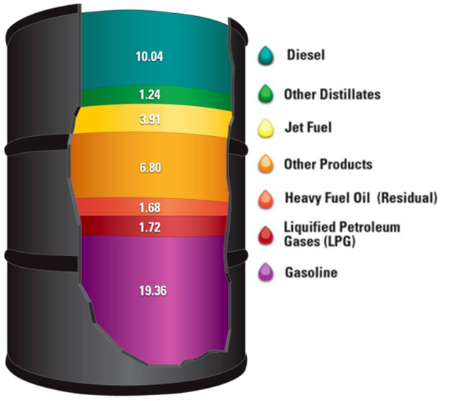
What is crude oil?
What are uses of crude oil?
How crude oil production is done?
How we send crude oil to customers?

Slide 5

What is future of oil?
What is supply figures in crude oil?
What is demand figures in crude oil?
What is historical performance of crude oil prices?
What is forecast for crude oil prices?

Slide 6
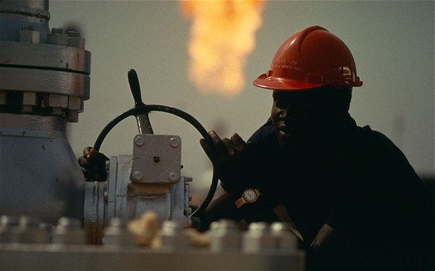
What is the status of Nigerian crude oil fields?
What is the history of Nigerian crude oil fields?
Which companies currently invested?
What are their returns?

Slide 7
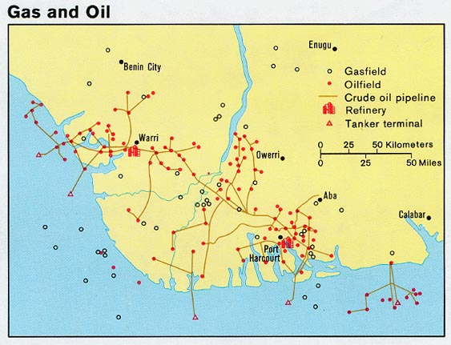
Why should we choose Nigeria for our investment?
What are the incentives for investing in Nigeria?
What are risks of investing in Nigeria?
What are regulations over crude oil production?
What are costs of investing in Nigerian crude oil fields?

Slide 8

Problem Solving Techniques
Paraphrase
  Restate the problem using different words without losing the original meaning. Trying to say the same thing with different words puts a slightly different spin on the meaning, which triggers new perspectives and informative insights.

Slide 9
Problem Solving Techniques
180 Degree
  Turn the problem on its head. Taking the opposite view not only challenges the problem's underlying premises but also directly identifies what is causing the problem.
Broaden the focus
  Restate the problem in a larger context, Look at the implications of the initial problem beyond the confines of your own organization.

Slide 10
Problem Solving Techniques
Ask “why?”
  Ask “why” of the initial problem statement. Then formulate a new problem statement based on the answer. Then ask “why” again, and again restate the problem based on the answer. Repeat this process a number of times until the essence of the “real” problem emerges. Restating a problem several different ways is a divergent analytical technique that opens the mind to alternatives.

Slide 11
Resources
Grey Literature
  “Grey literature, regardless of media, can include, but is not limited to, research reports, technical reports, economic reports, trip reports, working papers, discussion papers, unofficial governement documents, proceedings, preprints, research reports, studies, dissertations and theses; trade literature, market surveys, and newsletters. This material cuts across scientific, political, socio-economic, and military disciplines.”

Slide 12
Resources
Governmental Websites
  Offical Website of the Nigerian Investment Promotion Commission (NIPC) http://www.nipc.gov.ng/
  Official Website of the Nigerian Export Promotion Council http://www.nepc.gov.ng/
  Official Website of the Federal Ministry of Finance http://www.fmf.gov.ng/
  Official Website of the Nigeria Petroleum Technology Development Fund http://www.ptdf.gov.ng/

Slide 13
Resources
Search Engines
  http://www.google.com/
  http://www.bing.com/
Academic Databases
  Google Scholar http://scholar.google.com/
  African Journals Online (AJOL) http://www.ajol.info/
  Web of Knowledge http://www.webofknowledge.com/
  The Information Bridge: U.S Department of Energy Scientific and Technical Information http://www.osti.gov/bridge/
  OpenGrey Grey Literature database http://www.opengrey.eu/

Slide 14
Resources
News Websites
  Reuters http://www.reuters.com/
  BBC News http://www.bbc.co.uk/news/world/
  Vanguard Nigerian News Website http://www.vanguardngr.com/
  NigeriaWorld Nigerian News Website http://www.nigeriaworld.com/
  The Guardian Nigerian News Website http://www.ngrguardiannews.com/

Slide 15
Source Evaluation
Authority
Is it clear which organization is behind the contents of the page?
Is there a link to a page describing goals of the organization?
Is there a way of verifying the legitimacy of this organization?

Slide 16
Source Evaluation
Accuracy
Are the sources for any factual information clearly listed so they can be verified in another source?
Is the information free of grammatical, spelling, and typographical errors?

Slide 17
Source Evaluation
Objectivity
Are the sources for any factual information clearly listed so they can be verified in another source?
If there is any advertising on the page, is it clearly differentiated from the informational content?

Slide 18
Source Evaluation
Currency
Are there dates on the page to indicate:
  When the page was written?
  When the page was first placed on the web?
  When the page was last revised?
Are there any other indications that the material is kept current?

Slide 19
Source Evaluation
Coverage
Is there an indication that the page has been completed, and is not still under construction?
Is it clear what topics the page intends to address?
Does the page succeed in addressing these topics, or has something significant been left out?
Is the point of view of the organization presented in a clear manner with its arguments well supported?

